Slide 1
TA JIANG CO., LTD.
(Stock Code : 1453 TT)
Ta Jiang Beauty tree Project
Presentation for Investor Conference
December 2, 2022

Slide 2
Disclaimer
This presentation is for reference only and is not a complete description of the Company’s operations. Contents within this report are based on the company’s predictions of future operations and are prospective descriptions that contain elements of risks and uncertainty. Hence the actual results of business operations might differ to the descriptions in this report.
If the content is related to the forecast information, the Company does not guarantee the correctness or reliability of the content. The user should judge and take risks at their own discretion.

Slide 3
Company Profile
Established in 1978/04/15
Listed on TWSE in 1993/04 (1453 TT)
Registered Capital:NT$1 ,036,334,300(as of 2022/11/30)
Main Business:Real Estate Development (as of 2022)
Company Website:www.tajiang.com.tw

Slide 4
Company History
1978 Former chairman of the board founded the Ta Jiang textile co.,
ltd in Taipei city.
1979 The purchase of Yunlin County Cih-tong Township Tai po tail
section land , and with the government incentives, establish the
Ta Jiang industrial zone with the Ta Jiang construction company
, and the construction of cotton spinning mill, for the first domestic
to its own funds to develop industrial areas of private enterprises.
1993 The Company is approved by the Securities and Exchange
Commission and the shares are listed on the Taiwan Stock Exchange.
1998 In line with the Company's business diversification, officially
branched out into construction business.
2018 The Company sells the spinning mill land and plant to Kenda Rubber
Industrial Co., Ltd.
2021 The Company's listing category was reclassified as construction stock

Slide 5
Operation Overview-Construction Department
Sales Project
Area | Project name | Location | Product | Total Sales Amount (NT$100million) | Remarks
Taipei City | Ta Jiang feng zhe | Jhongjheng Dist | Residential | 2.9 | Sale Rate 100%
New Taipei City | Ta Jiang Beauty tree | Hsin-chung Dist | Residential | 2.0 | Existing Home
New Taipei City | Ta Jiang shui yan | Sanchang Dist | Residential | 6.9 | Pre-Sale
Total | 3 Projects |  |  | 11.8

Slide 6
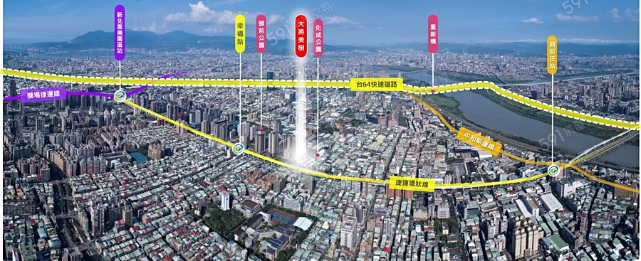
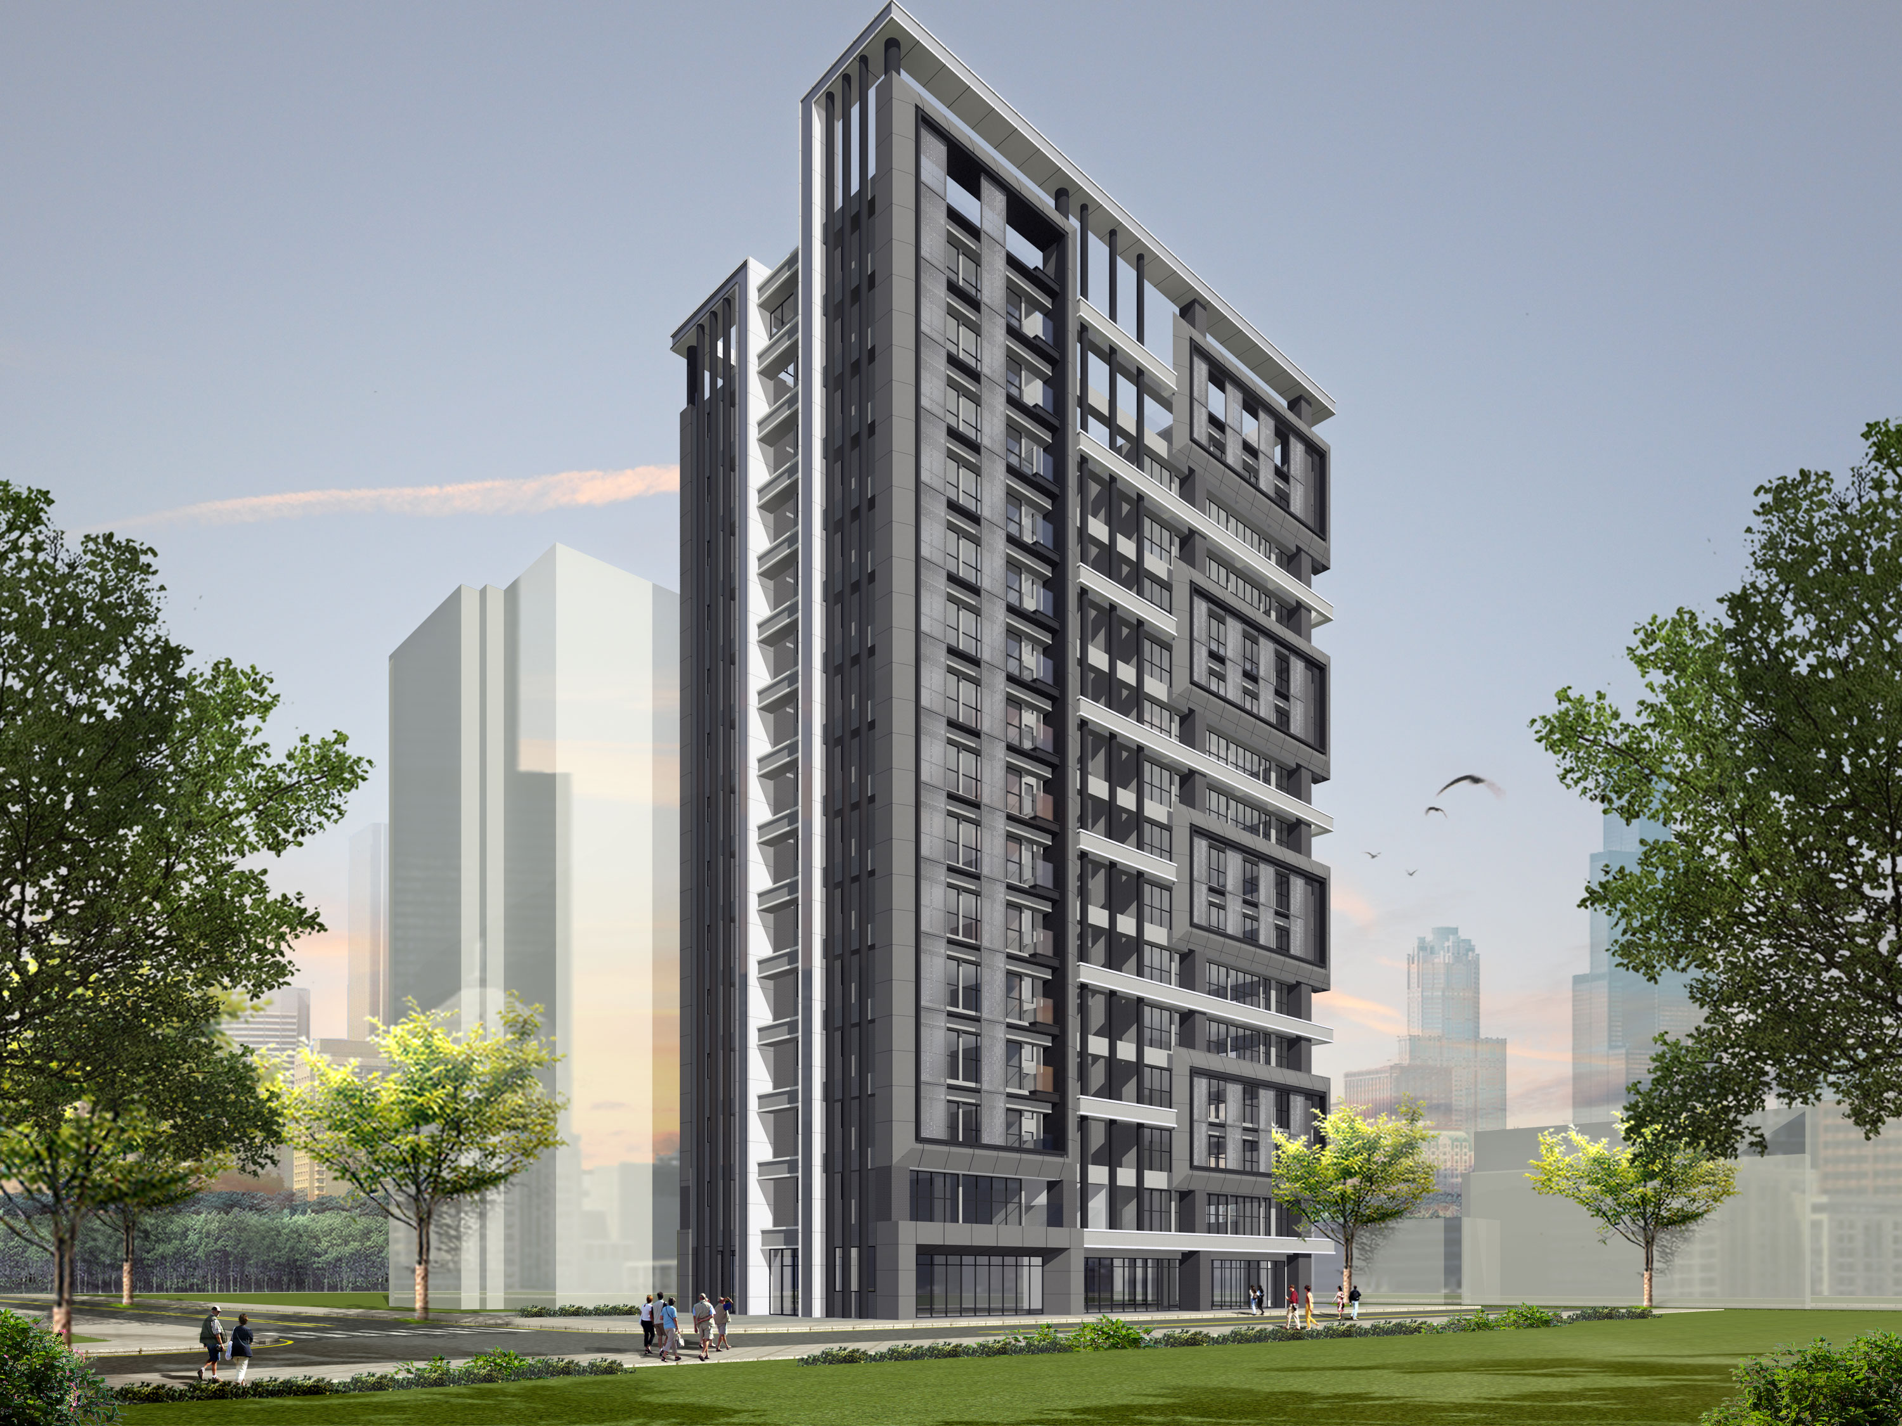
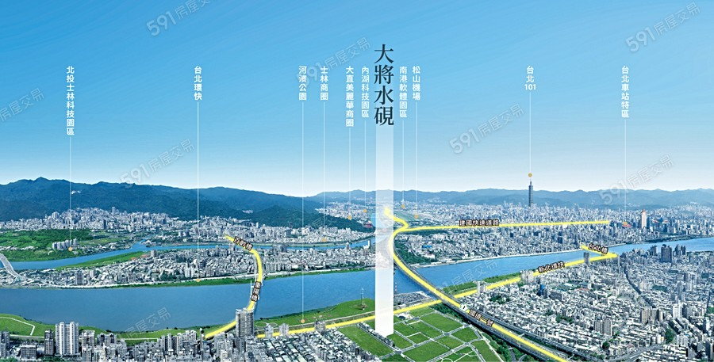
Operation Overview-Existing Home Sales Status
Ta Jiang Beauty tree Project The base area is 191 square meters/11 houses in total 10 stories above ground、2 stories below ground
Total sales amount：200 million
Features：Hsin-chuang huacheng park aside、sit in the park and green space、 Hsin-chuang
living area、downtown quiet The MRT nearby、traffic core
Ta Jiang shui yan Project
The base area is 498 square meters/34 houses in total 15stories above ground、4stories below ground
Total sales amount：690 million
Features：The project is located in the Sanzhong Renyi Rezoned Area, adjacent to the Danshuihe Riverside Sanzhong Sanhe, Longmen and other hot business districts, Naozhongcuo Quiet, where the Chongyang Bridge and the expressway converge, it is an excellent location in New Taipei City

Slide 7
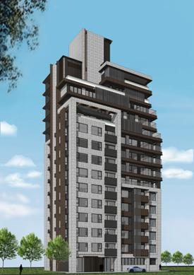
Construction in Progress
Operation Overview-Construction Department
Project | Location | Units | Expected date of occupancy permit | Base area ( ping ) | Total Sales Amount (NT$100million)
Ta Jiang shui yan | Hsin-chuang Dist | 34 | 2024 | 498 | 6.9
Ta Jiang celebrity alley | Da an Dist | 26 | 2025 | 157 | 11.5
Taipei City, Shilin Dist, Tianmu Sec | Shilin Dist | 23 | 2025 | 259 | 9.5
Total |  |  |  |  | 27.9
Ta Jiang celebrity alley
Product:pure residential
planning:9 stories above ground、4 stories below ground
Features：The project is located at Lane 26, Section 4, Zhongxiao East Road, Taipei City, near MRT Zhongxiao Fuxing Station and Zhongxiao SOGO business districts
Shilin Dist, Tianmu Sec
Product:pure residential
planning:15 stories above ground、4 stories below ground
Features：The project is located at Lane 81, Section 7, Zhongshan North Road, Taipei City, near the Tianmu shopping district

Slide 8
Land Bank and Planned Projects
Project Name | Location | Product | Area of Site (ping) | Total Building Area Sold (ping) | Total Sales Amount (NT$ 100 milion)
Yingge Dist , Jhongshan Sec | New Taipei City , Yingge Dist | Residential | 821.34 | 1784.27 | 4.27
Hsin-chuang Dist, Haishantou Sec | New Taipei City, Hsin-chuang Dist | Residential | 1,053.51 | Urban land readjustment | Urban land readjustment
Total |  |  | 1,874.49 | 1784.27

Slide 9
Urban Renewal
Project Name | Location | Area of Site (ping) | Planning and Design Products | Implementation Schedule | Total Building Area Sold (ping)
New Taipei City , Sindian Dist , Guangming Sec , Wunshan Sec | New Taipei City , Sindian Dist | 1,452.12 | Residential 14 F above ground,5F under ground | Urban Renewal Project Plan Approval Announcement | 3,989.36
New Taipei City , Sijhih Dist , Zonta Sec , Sinfong Sec | New Taipei City , Sijhih Dist | 1,918.25 | Residential 11 F above ground,3F under ground | Urban Renewal Project Plan Approval Announcement | 3,909.12
Taipei City , Sinyi Dist , Fude Sec | Taipei City , Sinyi Dist | 570.82 | Market Land 18 F above ground,4F under ground | Project plan and right transfer report resubmitted for review | 1,692.00
Taipei City , Songshan Dist , Meiren Sec | Taipei City , Songshan Dist | 1,004.91 | Residential 14 F above ground,3F under ground | In contract with landowner | 1,656.84
Taipei City, Datong Dist, Bridge North Sec | Taipei City, Datong Dist | 621.87 | Residential 12 F above ground,4F under ground | Project plan and rights transfer under review | 1,805.00
Taipei City, Shilin Dist, YongxinˉSec | Taipei City, Shilin Dist, | 845.79 | Residential 18 F above ground,3F under ground | Project plan and rights transfer under review | 3,236.55

Slide 10
Operation Overview-Future 5 Years Plan
Project Name | Total Building Area Sold (ping) | 2023 | 2024 | 2025 | 2026 | 2027
Yingge Dist , Jhongshan Sec | 1,784.27 |  | ● | ●
Hsin-chuang Dist, Haishantou Sec | Urban land |  |  |  | ● | ●
Ta Jiang Beauty tree | 331.00 | ●
Ta Jiang shui yan | 1,033.95 | ● | ●
Ta Jiang celebrity alley | 776.55 |  | ● | ●
Taipei City, Shilin Dist, Tianmu Sec | 865.75 |  |  | ● | ●
New Taipei City , Sindian Dist , Guangming Sec , Wunshan Sec | 3,989.36 |  |  |  | ● | ●
New Taipei City , Sijhih Dist Zonta Sec | 3,909.12 |  |  | ● | ●
Taipei City , Sinyi Dist , Fude Sec | 1,692.00 |  |  |  | ● | ●
Taipei City , Songshan Dist , Meiren Sec | 1,656.84 |  |  |  | ● | ●
Taipei City, Datong Dist , Bridge North Sec | 1,805.00 |  |  | ● | ●
Taipei City, Shilin Dist, Tianmu Sec | 3,236.55 |  |  | ● | ●

Slide 11
Financial Status
In thousands of NT
Consolidated Balance Sheets | 2018 | 2019 | 2020 | 2021 | 2022 (as of 2022.9.30)
Building and Land Held for Sale | 39,171 | 38,684 | 0 | 269,435 | 0
Land Held for Construction | 298,877 | 260,954 | 491,433 | 861,460 | 802,680
Construction in Progress | 237,257 | 220,740 | 232,289 | 66,159 | 123,313
Inventories Subtotal | 575,305 | 520,378 | 723,722 | 1,197,054 | 985,993
Inventories-Manufacturing | 425 | 154 | 0 | 0 | 0
Property,Plant and Equipment | 144,323 | 156,246 | 175,342 | 174,154 | 173,844
Cash and Other Assets | 134,998 | 144,501 | 155,803 | 157,231 | 174,602
Financial assets at fair value through profit or loss | 487,505 | 495,298 | 300,909 | 365,151 | 461,464
Total Assets | 1,342,556 | 1,316,577 | 1,355,776 | 1,893,590 | 1,795,903
Total Liabilities | 19,182 | 38,619 | 62,517 | 494,301 | 408,010
Stockholders Equities | 1,323,374 | 1,277,958 | 1,293,259 | 1,399,289 | 1,387,893
Current Ratio | 5,937.96 | 2,860.01 | 1,802.16 | 473.43 | 540.47
Debt Ratio | 1.43 | 2.93 | 4.61 | 26.10 | 22.72
Net Assets Value | 14.62 | 12.83 | 12.72 | 13.79 | 13.27

Slide 13
Company Operation Analysis
Financial Status
In thousands of NT
Consolidated Income Statements | 2018 | 2019 | 2020 | 2021 | 2022 (as of 2022.9.30)
Operating Revenue | 28,277 | 44,760 | 219,411 | 44,286 | 248,384
Operating Cost | 28,755 | 84,920 | 174,701 | 18,379 | 233,217
Gross Profit(Loss) | (478) | (40,160) | 44,710 | 25,907 | 15,167
Operating Expenses | 40,433 | 32,619 | 34,080 | 35,533 | 40,654
Operating Income (Loss) | (40,911) | (72,779) | 10,630 | (9,626) | (25,487)
Non-Operating Income and Loss | 376,772 | 27,793 | 4,346 | 121,504 | 17,358
Pre-tax Income(Loss) | 335,861 | (44,986) | 14,976 | 111,878 | (8,129)
Net Income(Loss) | 335,237 | (45,416) | 15,301 | 106,030 | (11,396)
Comprehensive Income(Loss) | 335,237 | (45,416) | 14,950 | 106,039 | (11,401)
Earnings per Share | 3.74 | (0.46) | 0.15 | 1.05 | (0.11)

Slide 14
Thank you for your support
Q & A
TA JIANG CO., LTD.

